Slide 1

Denver Gophers Meetup 2/26
Organizers: Scott Carrington, Brendon Kay, Natasha Dykes, William Chadwick
WIFI: Padawan | welcometocode
Bathrooms: Either side of the kitchen

Slide 2
Tonight’s Agenda
Tonight’s Agenda
6:30 – 6:40 – Kickoff & Intros
Name, company/school, role
How long you’ve been using Go
What you’re building (or want to build) with Go​
6:40 – 7:30 – Feature Talk
Zach Collier – Coze: Real-world Go in production
Architecture, tradeoffs, lessons learned, etc..
7:30 – 7:45 – Q&A & Lightning Chat
Follow-up questions
Share wins, blockers, or tools you love
7:45 – Late – Social @ Improper City
Drinks, networking, and more Go war stories

Slide 3
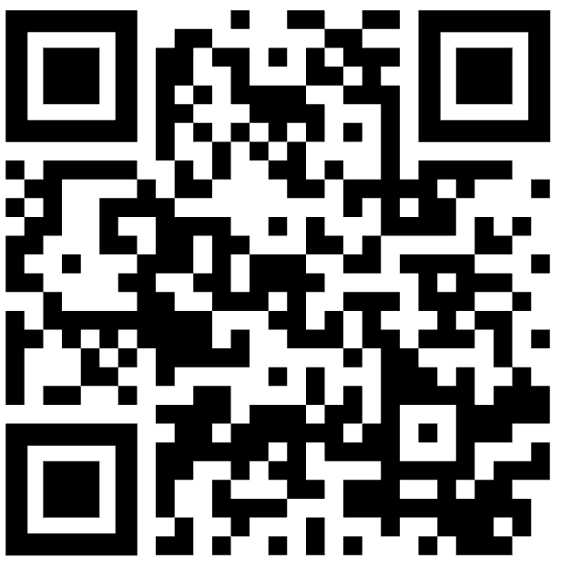
Community & Resources
Go Denver GitHub:
https://github.com/godenver
Central home for meetup resources
Add your own links, talks, and code via PRs
Goal: Every talk ends up here with slides, code, or notes

Slide 4
Community & Resources
How to Get Involved
Propose a talk (any level: beginner to deep dive)
Share job postings or hiring needs
Suggest topics for future meetups (tooling, testing, performance, etc.)

Slide 5
